Slide 1

Dr.Lankapalli Bullayya Degree & PG College Team Leader ( Aguru Raviteja ) Arjalla Hareesh Baswa David Raju Dasari Pardha Saradhi

Slide 2
Index
Part-1: Brand study, Competitor Analysis & Buter’s/Audience’s Persona
Part-2: SEO & Keyword Research
Part-3: Content Ideas and Marketing Strategies
Part-4: Content Creation And Curation (Post creations, Designs/Video Editing, Ad Campaigns over
Media and Email Ideation and Creation)

Slide 3

Part-1 Brand study, Competitor Analysis &
Buyer’s/Audience’s Persona
Research Brand:
Mission/Values: Britannia missions were largely driven by the desire to expand British influence and territories across the globe. This often involved the establishment of colonies, protectorates, and spheres of influence in various regions.
USP: The Unique Selling Proposition (USP) of Britannia during its peak as the symbol of the British Empire was multifaceted, reflecting the empire's dominance, influence, and perceived superiority on the global stage.
Analyze Brand Tone and Identity: The brand tone and identity of Britannia encompass its historical associations with imperialism, patriotism, and cultural hegemony, as well as its contemporary or reimagined meanings, which may involve nostalgia, complexity, and cultural symbolism.

Slide 4
Brand study (Mission/Values & USP)
Mission/Values:
The Britannia is a term often associated with the British Empire, particularly during its peak in the 19th and early 20th centuries. It represents the idea of British imperialism, expansionism, and the belief in British superiority and civilization. Britannia missions and values, therefore, would reflect the objectives, principles, and beliefs that guided British colonial endeavors during that time.
Civilizing Mission: Central to Britannia's values was the belief in the superiority of British civilization and culture. This notion often justified colonial rule as a means of "civilizing" and "modernizing" indigenous peoples in the colonies, often through the imposition of British institutions, language, and values.
Trade and Economic Dominance: Economic interests played a significant role in Britannia's missions. The British Empire sought to exploit the resources and markets of its colonies for the benefit of the imperial economy. This often involved the extraction of natural resources and the establishment of trade networks that favored British merchants and industries.
Militarism and Strategic Interests: Britannia missions were often supported by military force, as the British Empire used its military superiority to conquer and control territories. Military bases and naval supremacy were crucial for protecting British interests and projecting power globally.

Slide 5
Brand study (Brand Tone & KPI)
Brand Tone
The brand tone of Britannia, considering its historical connotations as a symbol of the British Empire, is typically characterized by several key elements:.
Simple Britannia KPIs may include
Revenue Growth: Measure the increase in revenue over time to gauge the company's financial health and market performance.
Market Share: Track the company's share of the total market it operates in to understand its competitiveness and growth potential.
Brand Awareness: Assess the brand's recognition and perception among consumers through surveys, social media mentions, and brand tracking studies.
Customer Satisfaction: Measure customer satisfaction through surveys, reviews, and feedback to ensure products meet or exceed expectations.

Slide 6
Buyer/Audience Persona
Name: Ravi Demographics:
Age: 5-35
Gender: All gender
Occupation:
Income: Middle to high-income individuals
Psychographics:
Value: Nulsi Wadia and Family of Britannia Industries is the richest biscuit manufacturer in the world.
Interests: The Britannia franchise business agreement is unmistakably a good investement.
Personality: Sincerity, Fun Loving, Reliable. The trending topics
of the world in a more sarcastic yet informative way.
Behavior:
Shopping habits: In the, customer’s buying decisions are
influenced by a wide range of feeling. “Consumer behaviour” refers to research on consumer buying…
Social media usage: It shares engaging and informative content
that not only showcases its wide range of products but also reinforces its brand values.
Goals:
Glike any other company, sets various goals and objectives to guide its strategic direction and drive growth. While specific goals may evolve over time based on changing market dynamics and business priorities.
Challenges:
Changing Consumer Preferences: Consumer tastes and preferences are constantly evolving, driven by factors such as health consciousness, convenience, and sustainability. Britannia must adapt its product offerings and marketing strategies to meet these changing demands.
Competition: The food industry is highly competitive, with numerous players vying for market share. Britannia faces competition from both domestic and international brands, requiring it to differentiate its products, innovate continuously, and invest in branding and marketing efforts.
Supply Chain Disruptions: Disruptions in the supply chain, such as raw material shortages, transportation delays, and logistics issues, can impact Britannia's production capabilities and product availability. Managing and mitigating these risks is essential to ensure uninterrupted operations.

Slide 7



Part 1: Brand study, Competitor Analysis & Buyer’s/Audience’s
Persona
Competitor Analysis: Analyzing Britannia’s competitor provides valuable insights into the dairy industry landscape. Here’s a brief competitor analysis each competitor brings unique strengths and strategies to the table, such as product innovation, marketing prowess, distribution networks, or brand loyalty. Can provide a comprehensive understanding of the competitive landscape for Britannia.
Nestle India: Nestle is a major competitor with a diverse product portfolio Including dairy products like milk, yogurt, and cheese. They focus on innovation Quality, and health-conscious products.
Parle Platina:Parle Platina is a premium range of biscuits offered by Parle Products Pvt. Ltd., one of the leading biscuit manufacturers in India. Parle Platina biscuits are positioned as high-quality, indulgent treats that cater to consumers looking for a premium snacking experience.
Amul Industries:Amul is a key player in the dairy segment with products like cheese, Milk, and dairy-based snacks. They focus on innovation and catering to changing consumer perferences.

Slide 8
Competitor 1: Nestle
USP: Nestle offers a wide range of food and beverage products, including dairy, coffee, baby food, confectionery, and health supplements. Consumers often associate Nestle with reliability and high standards. Nutrition and health in its products that align with consumer trends towards wellness, convenience, and sustainability it maintain a competitive edge in the food and beverage industry globally.
Online Communication:
Nestle maintains active profiles on major social media platforms Like Facebook, Twitter, Instagram, Linkedln, and YouTube. This Content aims to educate consumers, establish Nestle as an authority In the food industry, and create meaningful interactions with Followers respond promptly to customer inquiries, resolve issues, And maintain a positive brand image through effective Communication.

Slide 9
Swot
Strengths
Nestle is recognized globally for its trusted brands, quality products, and commitment to nutrition,
health, and wellness. The company’s strong brand equity instills consumer confidence and loyalty.
Innovation and R&D Nestle invests significantly in research and development, driving innovation in product formulations, packaging, sustainability, and health-focused initiatives.
Efficient Supply Chain well-established network ensuring timely delivery. Effective Marketing and
communication strategies.
Weakness
Overreliance on mature markets dependence on saturated markets for revenue growth.
Environmental Concerns criticisms related to environmental impact and sustainability practices.
Legal and regulatory challenges facing legal and regulatory hurdles in various markets.

Slide 10
Swot
Opportunities
E-commerce growth leverage digital platforms to enchance online sales and engage with customer directly, especially considering the ongoing trend towards online shopping
Emerging Markets focus on expanding in emerging markets where there is a rising middle class and increasing disposable incomes, providing a significant growth opportunity.
Innovation and research continue investing in R&D to innovate new products, improve existing ones, and stay ahead of marking trends and consumer preferences.
Threats
Competition intense competition from both global giants and local players in various product categories could lead to market share erosion and pricing pressures.
Regulatory challenges increasingly stringent regulations related to food safety, labeling, advertising, and environmental sustainability may impact operations and increase compliance costs.
Digital disruption from digital platforms, e-commerce channels, and direct-to-consumer modals could challenge traditional distribution networks and marketing strategies.

Slide 11

Competitor 2: Parle Platina
USP
Parle Platina biscuits are known for their rich flavor profiles, innovative recipes, and premium packaging. They are often marketed as suitable for special occasions, gifting, or as a luxurious indulgence for everyday snacking. With their focus on quality ingredients and appealing taste, Parle Platina biscuits aim to capture a segment of the market that values both flavor and sophistication in their snacks.
Online Communication:
Social media presence Parle Platina maintains active profiles on Popular social media platforms like Facebook, Instagram, Twitter, and Linkedln. Website Parle Platina’s official website serves as a central
Hub for information about its products, company values, sustainability efforts, and more. Email marketing
Parle Platina uses email marketing campaigns to reach out to subscribers with special promotions, new product launches, seasonal offers, and relevant content like recipes or health articles.

Slide 12
Swot
Strengths
Parle Platina biscuits are crafted using high-quality ingredients, ensuring superior taste, texture, and overall product experience. The use of premium ingredients enhances the perceived value of the product among consumers.
Parle Platina offers a diverse range of flavors and varieties, catering to different consumer preferences and taste profiles. This variety allows the brand to appeal to a broader audience and capture various segments of the market.
Affordable pricing while maintaining quality, Parle Platina offers its products at competitive prices,
making them accessible to a broad consumer base.
Weakness
Being positioned as a premium product, Parle Platina may face challenges in markets where consumers are highly price-sensitive. The higher price point could limit its accessibility to a broader audience, especially in economically constrained regions.
The premium biscuit segment is highly competitive, with several established players vying for market share. Competitors may offer similar or even better-quality products, posing a threat to Parle Platina's market position and sales.
Parle Platina's reliance on specific raw materials, such as high-quality ingredients, could pose a risk if there are fluctuations in supply or price volatility in the market.

Slide 13
Swot
Opportunities
Introducing new flavors, variants, or product lines within the premium biscuit category can help Parle Platina attract new customers and cater to changing consumer preferences.
Capitalizing on the growing demand for healthier snack options, Parle Platina can develop products that cater to health-conscious consumers.
Forming strategic partnerships with other brands or businesses, such as luxury hotels, airlines, or gourmet stores, can enhance Parle Platina's visibility and credibility.
Threats
Intense competition from existing premium biscuit brands as well as new entrants can threaten Parle Platina's market share and profitability.
Shifting consumer preferences, including evolving taste preferences, dietary trends, or health concerns, could pose a threat to Parle Platina's sales if the brand fails to adapt quickly enough
Disruptions in the supply chain, such as raw material shortages, transportation bottlenecks, or disruptions due to natural disasters or geopolitical events, can impact Parle Platina's production capacity and lead to product shortages or increased costs.

Slide 14
Competitor 3: Amul
USP
Amul’s unique selling proposition (USP) lies in its wide range of quality food products, focusing on taste, nutrition, and convenience. They often emphasize their commitment to using high-quality ingredients, maintaining stringent quality control standards, and catering to diverse consumer preferences with innovative flavors and packaging.
Online Communication:
Social media Amul maintains active profiles on platforms like Facebook, Twitter, Instagram, and Linkedln. They use these platforms to share product Updates, promotions, recipes, and engage with customers through comments, Messages and contests. It also includes features like online shopping, where
Customers can browse and purchase Amul products. Britannia may have mobile apps for specific purposes, such as recipe apps or loyalty programs, providing additional value and convenience to their
Customers.

Slide 15
Swot
Strenghts
Strong brand recognition and heritage diverse product range catering to varied preferences.
The strengths collectively contribute to Amul’s market leadership, customer trust , and sustained
growth in the food industry.
Effective marketing and advertising strategies commitment to corporate social responsibility financial stability and consistent growth.
Weakness
Limited presence in international markets compared to same competitors vulnerability to market
fluctuations in raw material prices.
Potential dependency on traditional distribution channels amid evolving consumer preferences for
online shopping.
Rick of consumer perception shifts due to health and wellness trends impacting certain product
categories.

Slide 16
Swot
Opportunities
Expansion into emerging markets with growing consumer demand for packaged food.
Diversification into new product categories or healthier alternatives to acter to changing consumer
perferences.
Strategic partnerships or acquisitions to strengthen market presence and capabilities.
Threats
Intense competition from both domestic and global food companies price volatility of key raw
materials affecting production costs.
Changing consumer preferences towards healthier and organic alternatives regulatory changes
impacting food labelling, advertising and product formulations
Disruptions in supply chain logistics due to external factors like natural disasters or geopolitical events.

Slide 17
Part 2: SEO & Keyword Research
SEO Audit: Do an SEO audit of the brands website
Keyword Research: Keyword research for Britannia would involve identifying relevant keywords related to their products, services, industry, and target audience. Understand Britannia’s Offerings, Identify Seed Keywords, Expand with Keyword Tools, Competitor Analysis, Consider User Intent, Local Keywords (if applicable), Evaluate Keyword Difficulty and Search Volume, Long-Tail Keywords, Brand- specific Keyword, Refine and Organize.
On page Optimization: Meta Tag optimization & Content optimization
Implementing these on-page optimization strategies can enhance the overall user experience, improve
search engine rankings, and drive organic traffic to Britannia’s website.
Social sharing integration include social sharing buttons to encourage user to share content on social
media platform, increasing visibility and angagement.

Slide 18
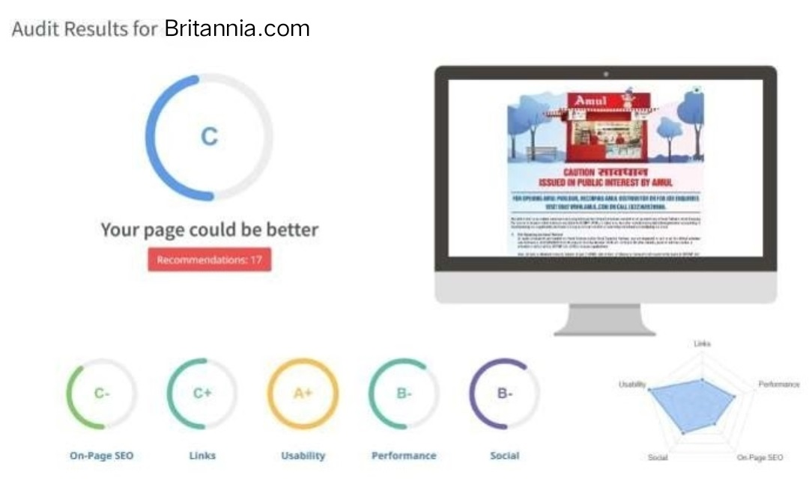
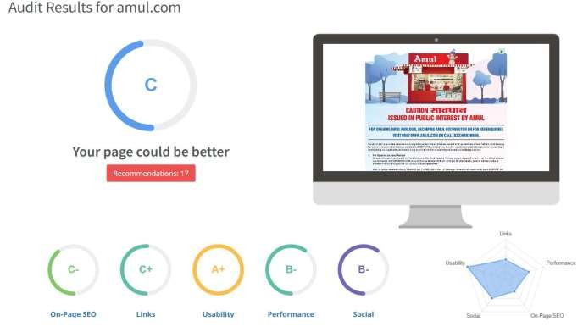
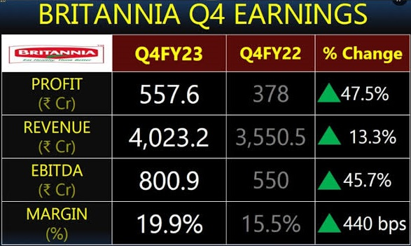
SEO Audit
The website’s SEO score is fair but there’s
room for improvement in building
and tailoring the content for a U.S. audience

Slide 19
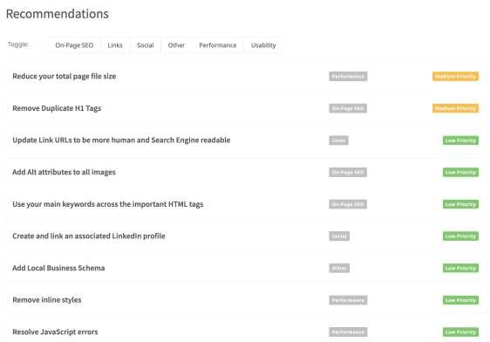
SEO Audit
•
Enchance image and asset
optimization by compressing files,
enchancing load times and user satisfaction. Remove redundant H1 tags to streamline content
Structure and enchance search engine
Understanding.

Slide 20
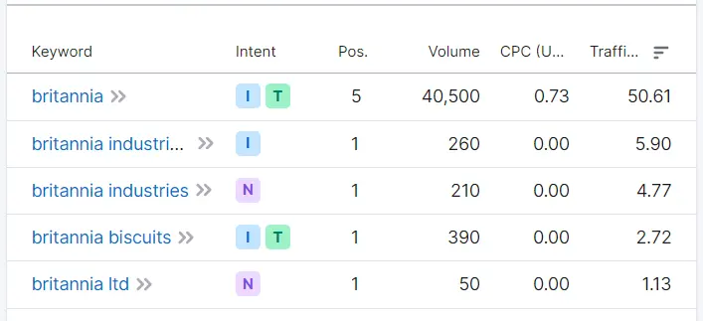
Keyword Research
Keyword Objective: Sale oriented
Britannia Biscuits
Britannia Cheese
Britannia Butter
Britannia cakes
We can use these 4 as primary Keywords since they have decent Volumes and are relevant to the
Brands products.

Slide 21
On page Optimization
Focus Keywords: Britannia biscuits, Britannia cakes, Britannia bread, Britannia franchise…… etc.
Meta Title
“Britannia India | Dairy Products, Butter,Yogurt,Milk, Cheese & More”
Meta Description
“Discover a wide range of dairy products at Britannia India. From creamy butter to delicious yogurt, nutritious snacks, and flavorful cheese, explore our quality offering. Learn about our brand history and find Britannia products near you”.

Slide 22
On page Optimization (Content Optimization)
Introduction:
Britannia Industries Limited is a leading Indian food-products corporation with a rich heritage spanning over a century. Established in 1892 in Kolkata, India, by a group of British businessmen, Britannia has evolved into one of India's most trusted and iconic brands in the food industry. Originally, the company began as a biscuit manufacturer, introducing its first biscuit in 1892. Over the years, Britannia has diversified its product portfolio to include a wide range of food items, catering to the diverse tastes and preferences of consumers across India and beyond.
Section 1: This section oversees the production facilities where Britannia's products are manufactured. It involves production planning, quality control, and maintenance of manufacturing equipment.
Section 2:R&D plays a crucial role in developing new products, improving existing ones, and innovating processes. This section focuses on food technology, product formulation, and consumer research.
Section 3: Responsible for promoting Britannia's products, managing distribution channels, and maintaining relationships with retailers and distributors. This section also conducts market research and develops marketing strategies to drive sales.
Section 4: This section manages the flow of raw materials and finished products, ensuring efficient transportation, warehousing, and inventory management. It plays a vital role in optimizing the supply chain to meet consumer demand while minimizing costs.
Conclusion: Britannia is synonymous with quality, innovation, and taste. Its products are crafted with a focus on using high-quality ingredients and maintaining stringent quality standards. The company has continually adapted to changing consumer needs and preferences, staying ahead of the curve in the dynamic food market.

Slide 23
Document the challenges faced during the research and analysis phase, as well as the key
insights gained from the keyword research process.
Getting a free tool to do keyword research is a task since most tools are paid.
We understood how the users search & gained insights into the kind of keywords people search for.
Choosing the right keywords was an issue there were a lot of relevant keywords in the list.

Slide 24
Part 3: Content Ideas and Marketing Strategies
Content Idea Generation & Strategy: Identify your purpose why you want to contact Britannia. Is it for a partnership, collaboration, feedback, or another reason? Clarifying your purpose will guide your strategy. Research conduct thorough research, services, recent news, and any ongoing initiatives. This will help you understand their business and how your idea can aligan with their goals.
Mentioned in the calendar.

Slide 25
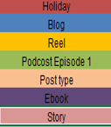
Content Calendar for the month of April 2024

Slide 26
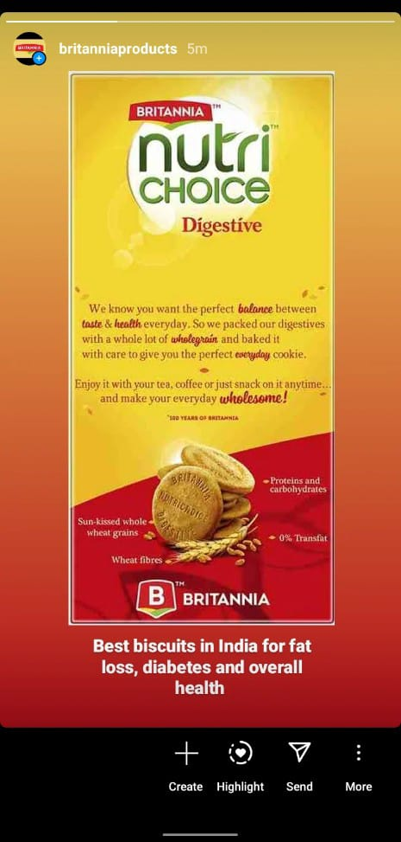
Strategy, Aim and the Idea behind this story
Could you provide more context or details
About the Britannia story or strategy you’re referring
To? Knowing a bit more about the Background or theme would help
Me provide a more accurate response.
The idea is that by having these
Engaging stories such as the format
It would engage follower and Position the brand as a trusted source of
Britannia advice

Slide 27
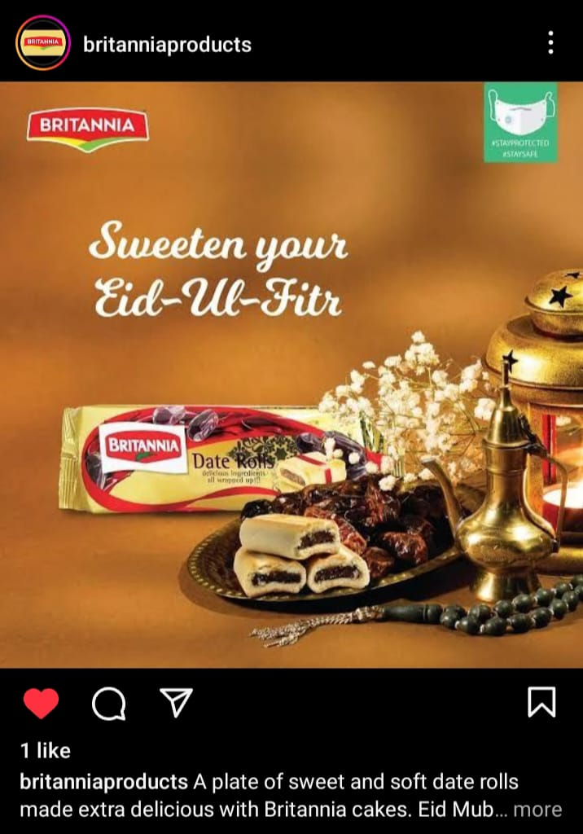
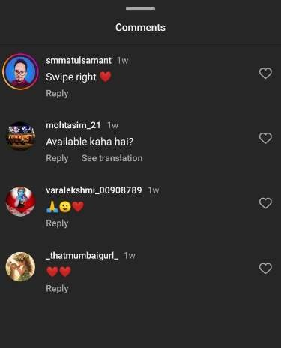
Strategy, Aim and the Idea behind this post
In the grand tapestry of strategies, the Britannia aim Unfurls like a delicate melody, weaving through The complexities of purpose and vision. The idea that propels this post transcends mere words;
It seeks to illuminate the path of innovation and insight,
Backoning us to explore new horizons and unlock
Hidden potentials. The idea would be to use a simple Creative to highlight the main USPs

Slide 28
Part 3: Content Ideas and Marketing Strategies
Britannia has leveraged various digital marketing channels such as facebook, Instagram and runs influencer
marketing and topical marketing campings.
In the realm of content ideas and marketing strategies for Britannia, envision a symphony of creativity and strategic brilliance .picture vibrant narratives celebrating the heritage and quality of Britannia products, resonating with warmth and nostalgia. Embrace innovative digital campaigns that connect with audiences on a personal level, fostering loyalty and advocacy. This harmonious blend of storytelling and strategic outreach embodies the essence of Britannia’s iconic brand journey.
Digital marketing channel including social media, e mail marketing and influencer collaborations to
promote its products and connect with its audience in the digital sphere

Slide 29
PART 4:Content Creation and Curation
Post Creation:
Select Content Categories: The Britannia Model of dairy development is a three tiered structure with the dairy cooperative societies at the village level federated under a milk union at the district level and a federation of members unions at the state level.
Format 1: Post
Format 2: Reel post
Format 3: Festival post

Slide 30
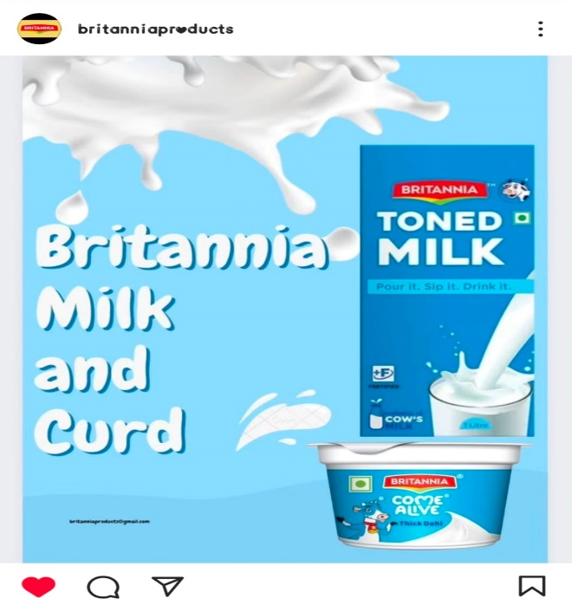
Format 1 : Static Post on Britannia Milk and Curd
Caption: You fly you try take it straight higher head higher reaching forward running, jumping,
fighting higher milk the world’s original energy drink. What would you call Dahi that’s thick, rich, tasty, versatile, and as good as homemade? We called it ‘Thick Dahi’…. Yaane Masti Dhai! Enjoy the Britannia Thick Dhai experience!
Link: https://www.instagram.com/p/C59zAUtPVzn/?igsh=MWptOXFxMjc5cnd2bw==
Post:
Hashtags: #Britannia Milk #Britannia curd

Slide 31
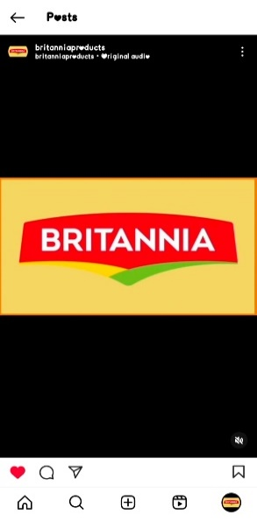
Format 2: Reel post on Britannia products
Caption: Raise the bar of love with Britannia dairy products, Every day love needs a bit of refreshment to reminisce about the good times, Let’s unite all our cheese flavours at the breakfast table, The natural goodness of Britannia Milk, It is probiotic low fat and has no added sugar, Savour the joy of your
special vacation traditions with the richness of Britannia Fresh Butter incomplete without whipping up
magical moves this happy special vacations.
Link: https://www.Instagram.com/reel/C576f89rSKg/?igsh=MWIvY3hpa2FoaGV4Mg==
Reel Post:
Hashtages: #Britannia#Butter#Lassi#choco lush #Milk#Dhai#Badam shake#Thick shakes

Slide 32
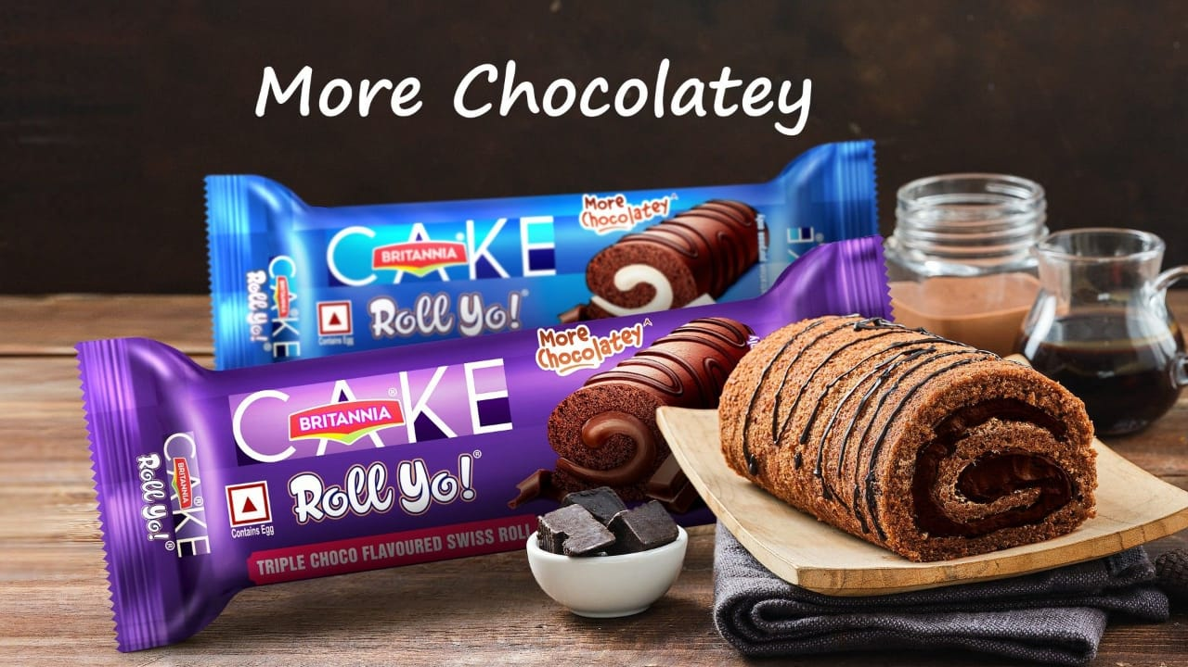
Format 3- Festivals Post on Britannia Rolls Yo!
Caption : Britannia Roll Yo! Has been a lipsmacking hit amongst kids from their first indulgent bite. Rich cremeswirled inside a soft cake, this swiss roll is a yummy treat for children and adults alike!
Link: https://images.app.goo.gl/EVpPWNdpSjv9yJTj7
Post:
Hashtags:#Chocorolls
#Britannia #choco#Rolls#Britannia cakes#Britannia rollyo!

Slide 33
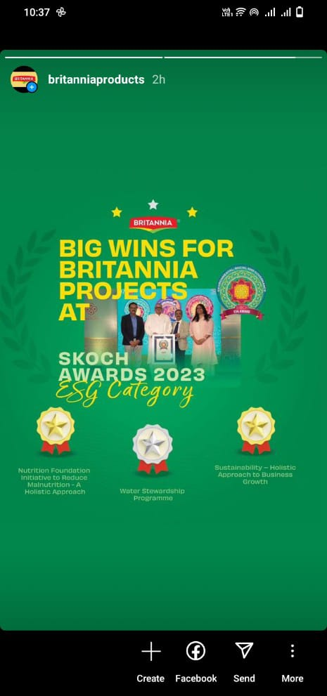
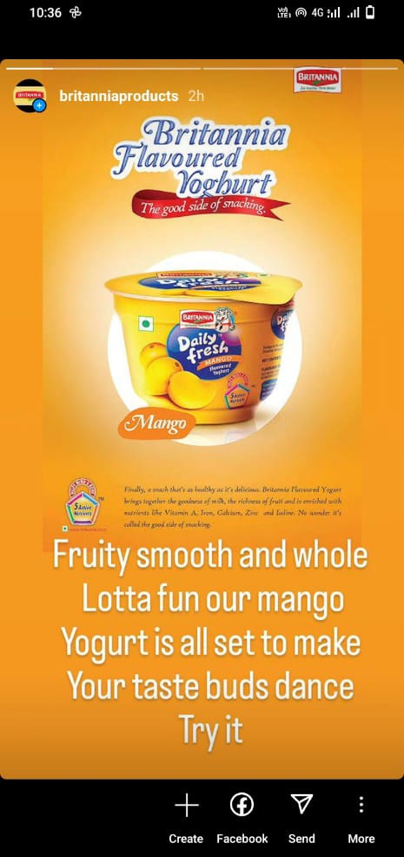
Instagram Story
Screenshots of story.
https://www.instagram.com/stories/britanniaproducts/22759519180792258?utm_source=ig_story_ite
m_share&igsh=NTc4MTIwNjQ2YQ==

Slide 34
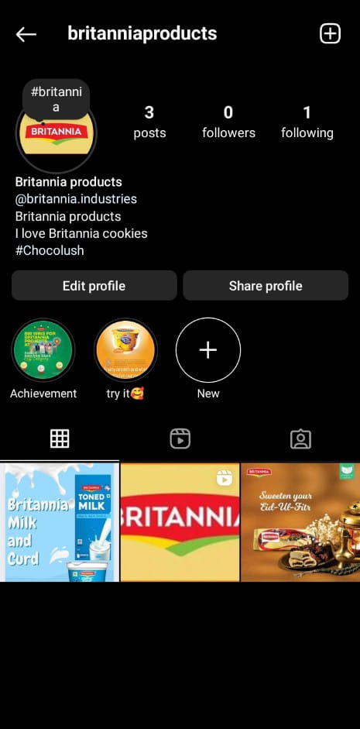
Highlights for Story.
https://www.instagram.com/s/aGlnaGxpZ2h0OjE4MDY5MDY4ODM2NTAwNjg5?story_media_id=33
51679519180792258&igsh=NTc4MTIwNjQ2YQ==

Slide 35
Story Insights – Q&A
Reach is Impressions is Like is
Etc….
Area for improvement:
In the subsequent years Britannia made cheese and baby food on a large commercial scale again
processing cow’s milk creating a history in the world.
Since the shares of Britannia’s journey from a small cooperative to a global brand is a remarkable tale of
resilience, innovation, and social impact.

Slide 36
Part 4: Content Creation and Editing
Designs/Video Editing
Design Tools Familiarization(use canva for creating visually appearing graphics)
Video Creation: Utilize VN or any video editor of your choice to create videos related to the chosen topic

Slide 37
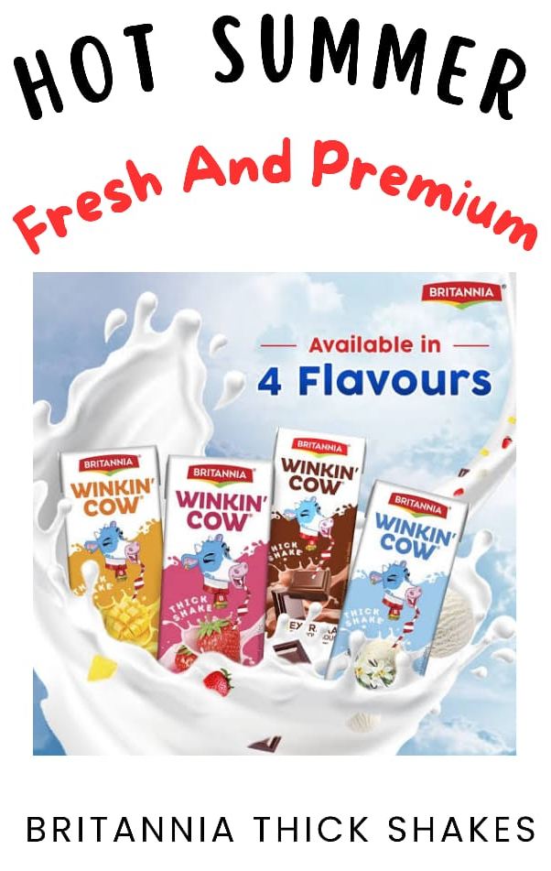
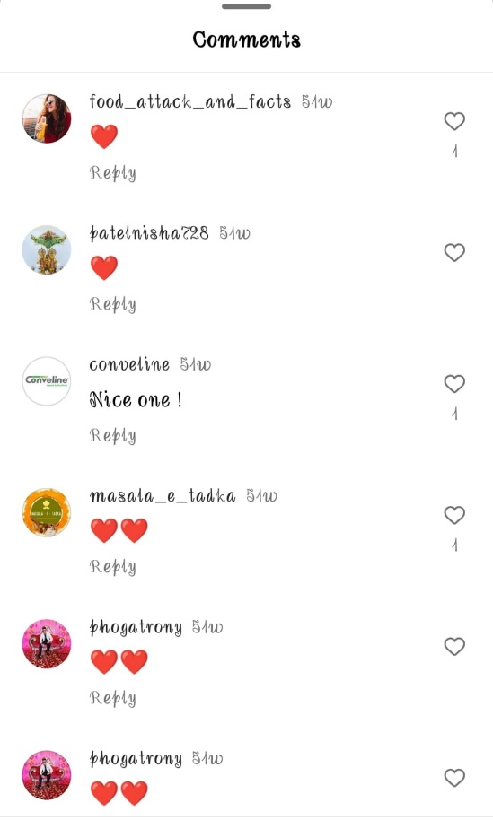
Instagram post
Caption : Britannia Thick Shakes Hot
Summer Fresh and Premium
Hastags: #Britannia #Thick Shakes
Link:
https://www.canva.com/design/DAGDNx_Lxgs/LKaJqWL2tJq PrIrYZYuobQ/edit?utm_content=DAGDNx_Lxgs&utm_camp aign=designshare&utm_medium=link2&utm_source=shareb utton

Slide 38
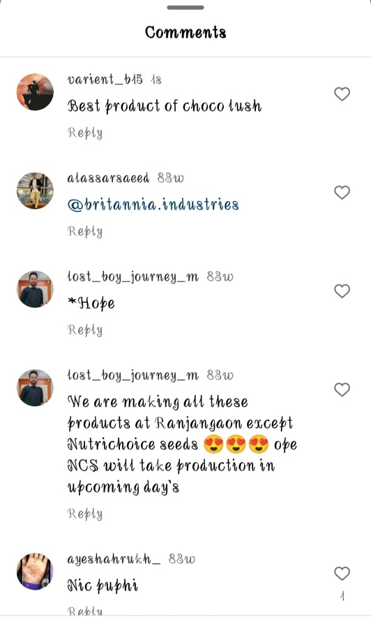
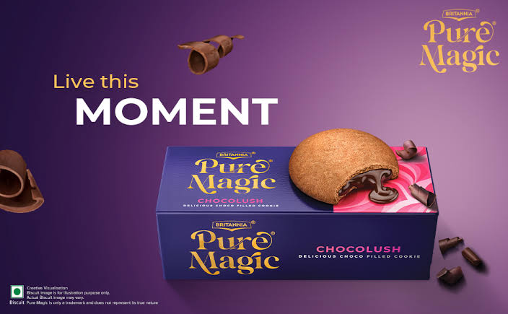
Instagram Story
Caption:Britannia yummy choco cookies feel the
yummy choco lush.
Hastags: #Britannia choco cookies #Britannia
Link: https://www.canva.com/design/DAGDN_g v55s/XrM5rtTMGex44aEiAmLKYQ/edit?ut m_content=DAGDN_gv55s&utm_campaign
=designshare&utm_medium=link2&utm_s
ource=sharebutton

Slide 39

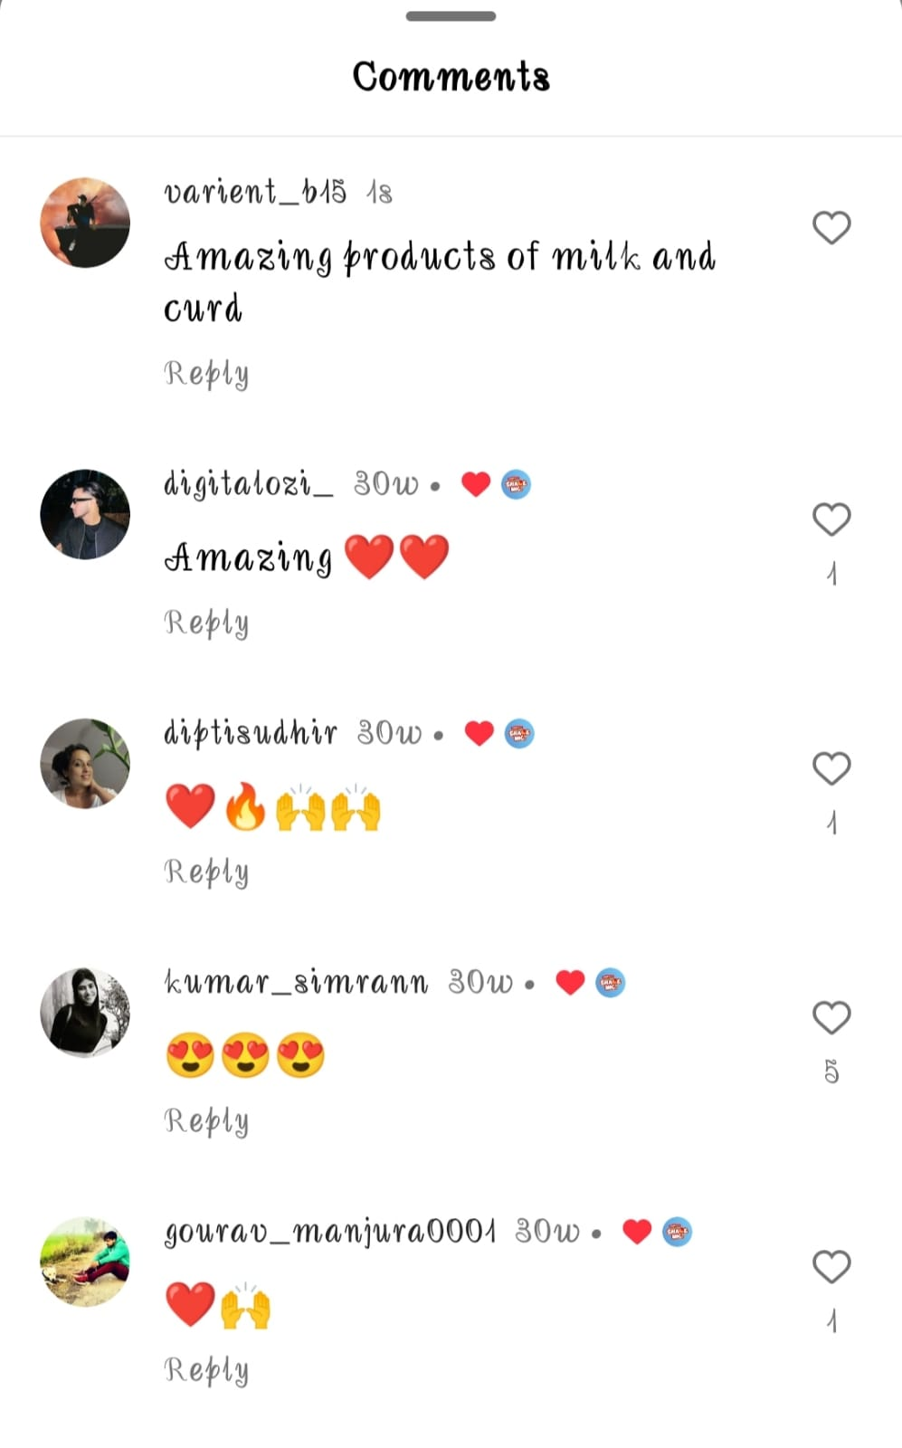
Instagram Story
Caption: Britannia Milk and Curd, Britannia dairy products
Be Honest, Be Natural
Hastags: #britanniamilk #britanniacurd
Link: https://www.canva.com/design/DAGDN0 XqMyY/MsUCArrAdD2QuB_1ebOb6g/edit? utm_content=DAGDN0XqMyY&utm_campa ign=designshare&utm_medium=link2&ut m_source=sharebutton

Slide 40
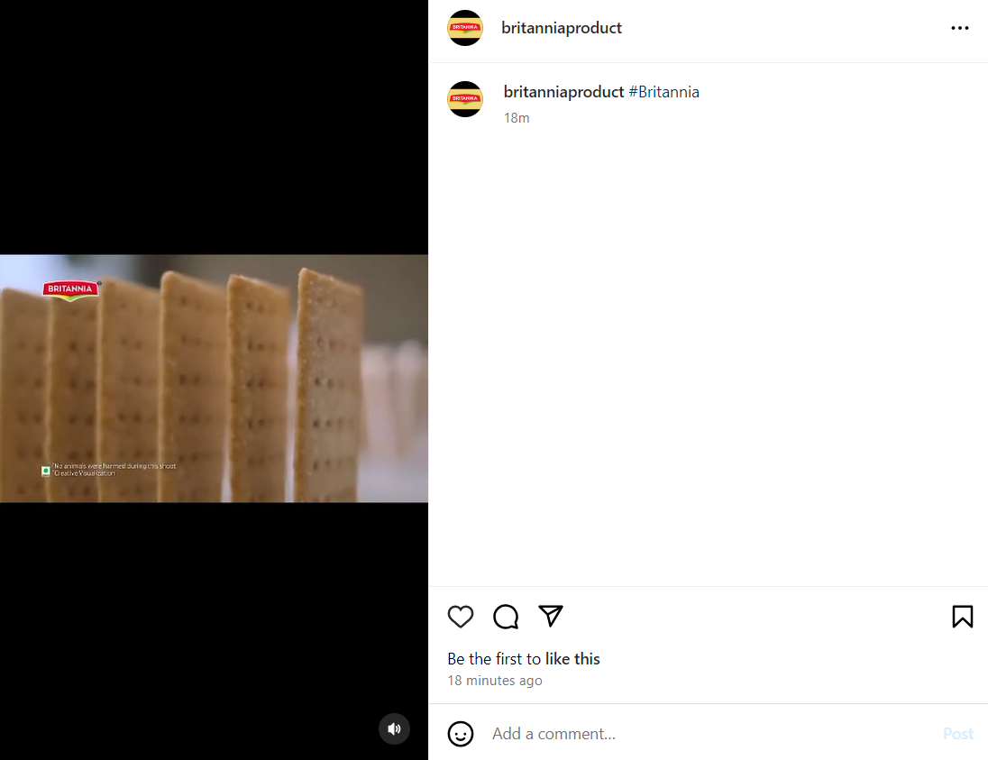
Instagram Ad Campaign
Caption : Britannia products Sale
Hastags : #Britannia#britanniaproducts
Link : https://www.instagram.com/reel
/C6lGuUQS1qx/?igsh=dXh
5em4xeDZjcHJ0

Slide 41
THANK YOU
Presented by
Aguru Raviteja
Arjalla Hareesh
Baswa David Raju
Dasari Pardha Saradhi

